Slide 1

JEDI BOOTCAMP
Presenter:
Kunal Sachdeva

Slide 2

Where I started?
Unaware of the industry development methods.
Pre learning materials cleared the basics.
…..

Slide 3
Framework for 3 weeks program
Duration : 16 Days
Discussion about the technology
Regular assignments
Timely reviews
Doubts clearing sessions
MCQ sessions

Slide 4
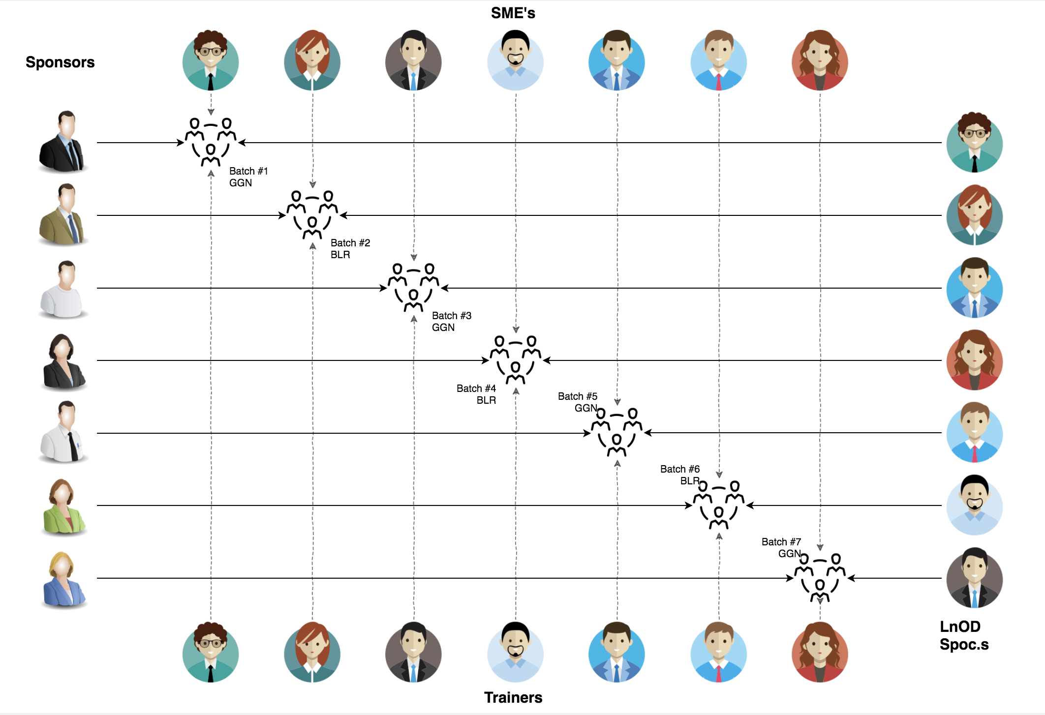
Stakeholders
Sponsors
Flipkart
L&D team
HR & Experts
SME’s
Trainers
Course-Coordinators

Slide 5
3 WEEKS OF TRAINING
16 DAYS
128 HOURS
7,680 MINUTES
460,800 SECONDS
LIMITLESS KNOWLEDGE

Slide 6

Agenda
01
Contents of the program
02
Our Team
03
Our Journey
04
Project Goals
05
Engineering Practices
06
Tech Stack
07
Challenges and Learnings
08
Demo
09
Questions
Notes:
Time – 1 min

Slide 7
Contents of the Program
Duration: 3 weeks
Unix and Linux Programming
Git and Github
UML (Unified Modelling Language)
Java (Core)
Rest APIs in Java
MySQL database
Dropwizard

Slide 8

OUR TEAM
Notes:
Time – 2 mins

Slide 9
Trainer : Mr. Amit Kr. Balyan
Trainee : Kunal Sachdeva

Slide 10

Our Journey
Notes:
Time - 2 mins

Slide 11



Slide 12
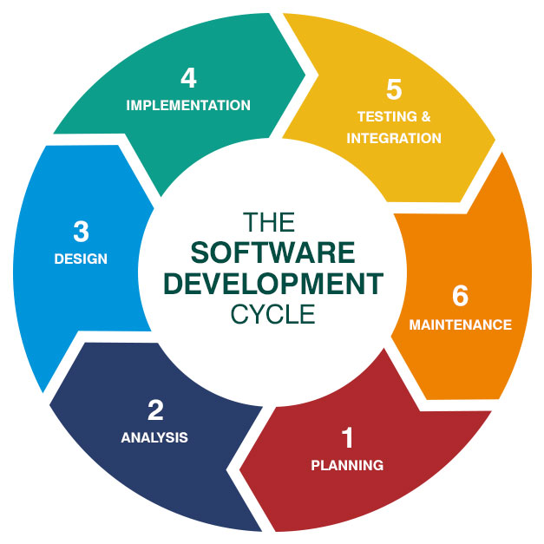


Slide 13
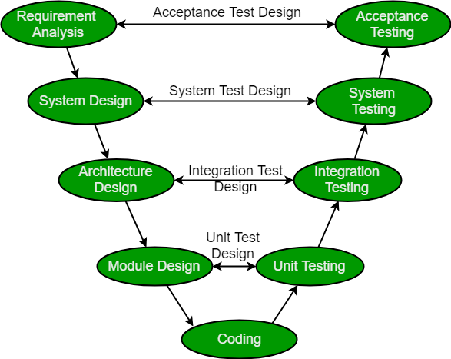

Slide 14

Java
Fundamentals

Slide 15

Database

Slide 16

Project Goals
Notes:
Time – 3 mins

Slide 17




Our Vision
To create a Student Management System using Java Development Tools, MYSQL having three user types:-
Student
Professor
Admin
with their specific roles and finally convert it into a REST based system using Jersey and Dropwizard.
1
2
Quality
Security
3
4
Interactivity
Speed
Notes:
User satisfaction and brand value

Slide 18
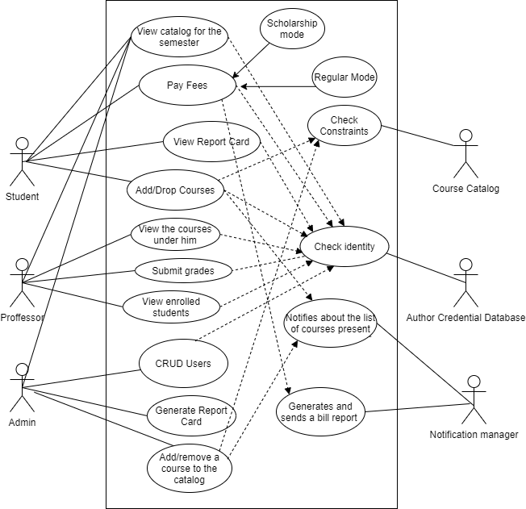
Use Case

Slide 19
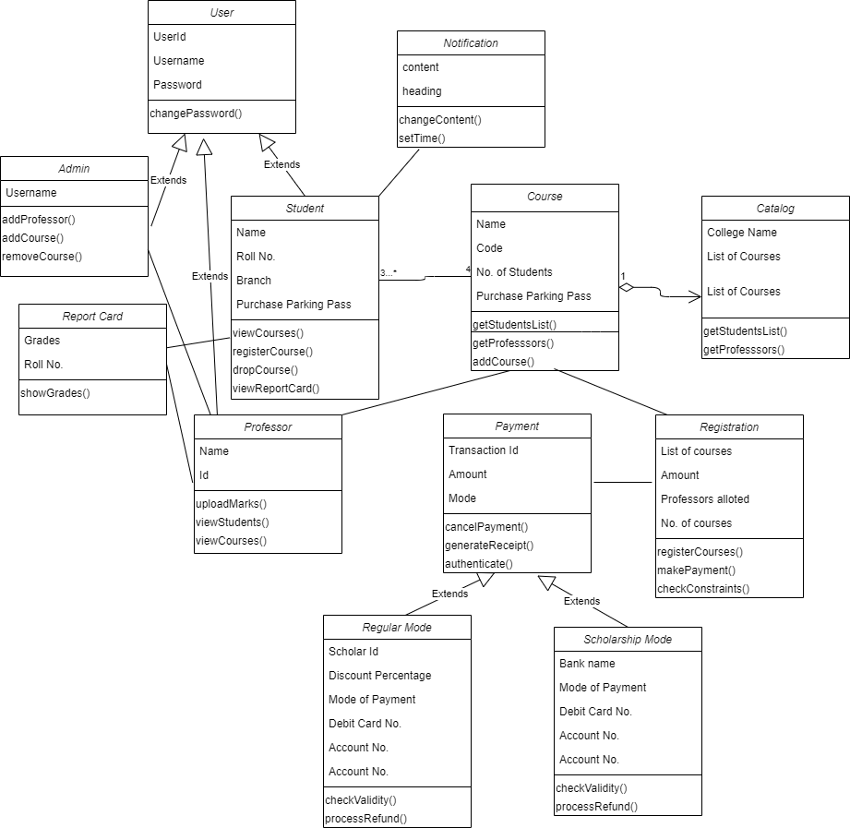
Class
Diagram

Slide 20
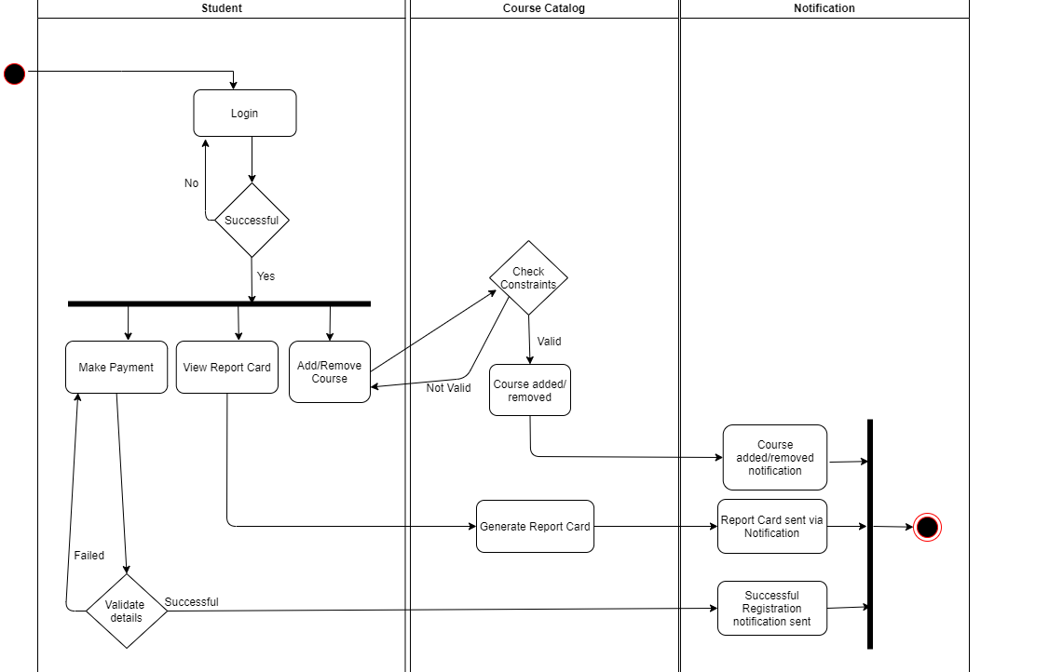
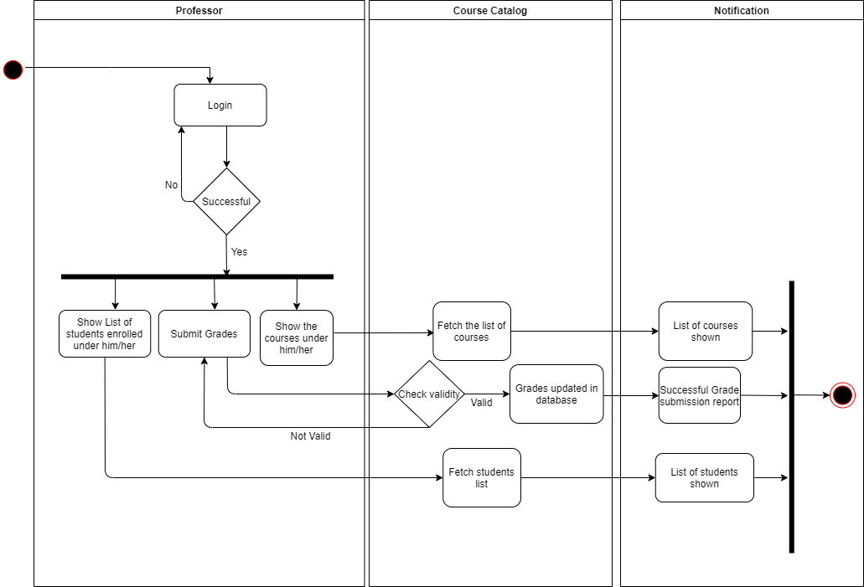
Activity Diagrams
Student
Professor

Slide 21
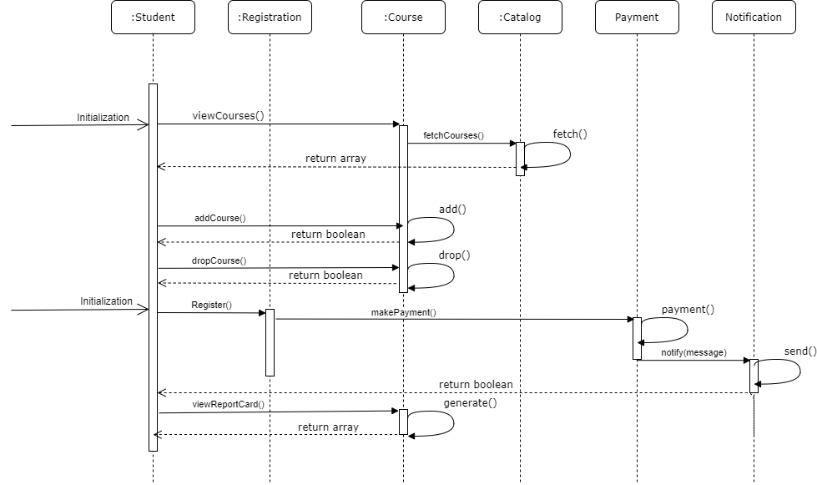
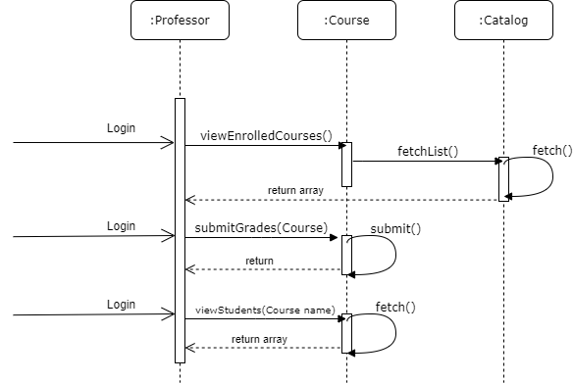
Sequence Diagrams
Student
Professor

Slide 22
Activity Diagrams Sequence Diagrams Component Diagrams
Deployment Diagrams
Other Diagrams

Slide 23
UML to CODE
Setting up the skeleton of the student management system.
Implementing the basic functionalities in JAVA.
Setting up all the use cases.
Initial code review.

Slide 24
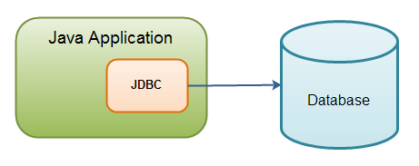
Integrating JAVA code with the database : JDBC

Slide 25
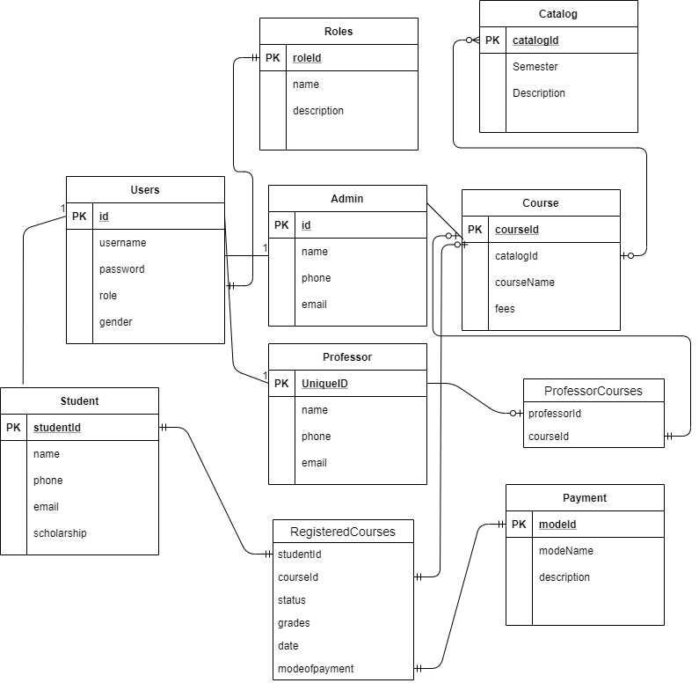
Database Schema

Slide 26

Taking the REST way!

Slide 27

Dropwizard

Slide 28

Engineering Practices
Notes:
Time – 5 mins

Slide 29
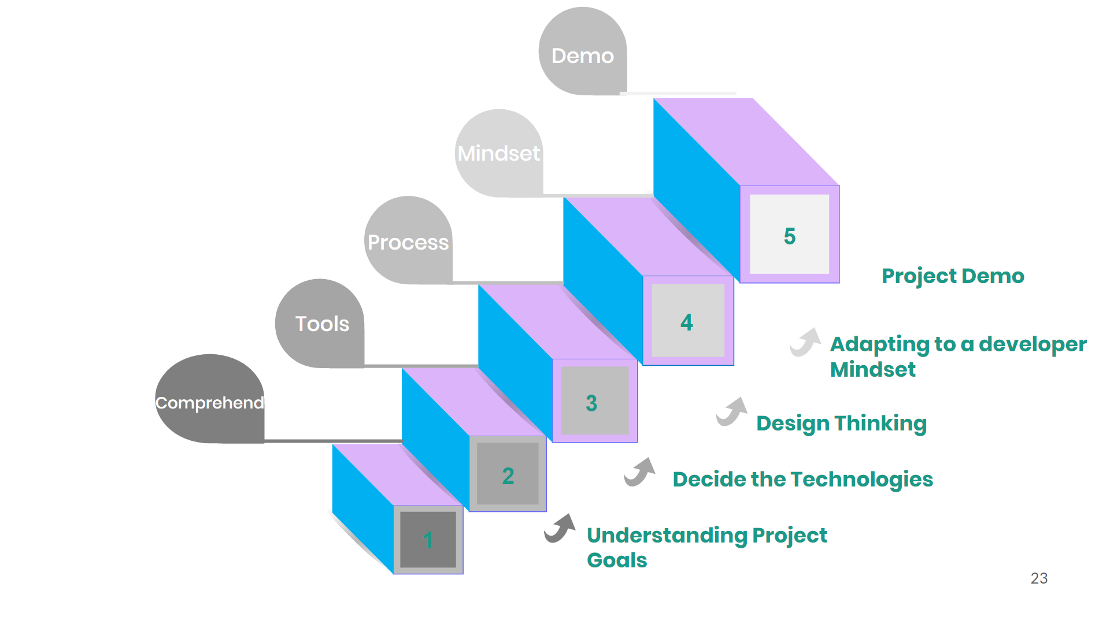

Slide 30
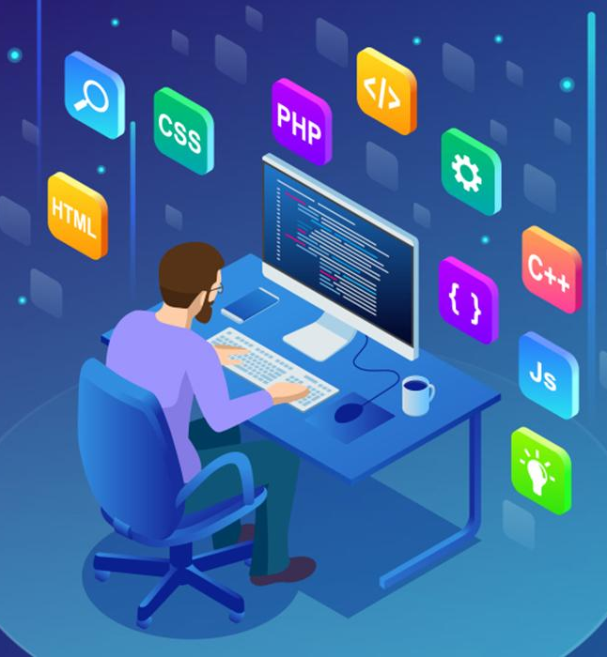
Tech Stack
Notes:
Time – 2 mins

Slide 31










Backend
Data
Others
Core Language
SQL Database
IDE
Framework
SCM
Application Server
Modelling
Notes:
Time – 1 min

Slide 32

Challenges & Learnings
Code refactor
Adapting the design models
Design practices
Code modularity
Notes:
Time – 2 mins

Slide 33

Demo

Slide 34

Questions
Notes:
Time - ?

Slide 35
Our next starts
NOW
Notes:
Time – 1 min
Swati

Slide 36
Thank you
Notes:
Time – After this show the testimonial video. 1 min

